Slide 1


CH 1 – Introduction to vectors Worked Examples Section 1.3
Ariel Guerrero Mat. 37877
ariel.guerrero@uc.edu.py
14/03/2024
Attribution-NonCommercial-ShareAlike 4.0 International (CC BY-NC-SA 4.0)

Slide 2
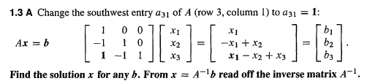
WE– 1.3.A
Página 27 [Strang,2009]

Slide 3
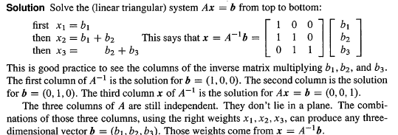
Solución:
Notes:
Graficos realizados en geogebra, cambiar a tickz

Slide 4
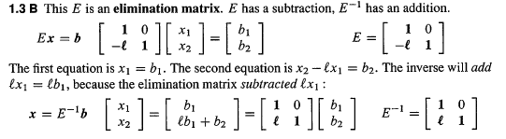
WE– 1.3.B
Página 28 [Strang,1993]

Slide 5
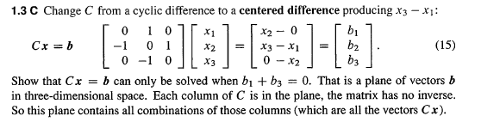
WE– 1.3.C
Página 28 [Strang,1993]

Slide 6

Solución:
Notes:
Graficos realizados en geogebra, cambiar a tickz

Slide 7
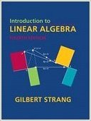
Créditos
Ariel Guerrero
ariel.guerrero@uc.edu.py
(+595) 981-425 040
Hernandarias – Paraguay
@2024
GitHub
https://github.com/aegiloru/linearAlgebra
MIT 18.06
https://ocw.mit.edu/courses/mathematics/18-06-linear-algebra-spring-2010/
Prof. Gilbert Strang
http://www-math.mit.edu/~gs/
Strang, G., Strang, G., Strang, G., & Strang, G. (1993).
Introduction to linear algebra (Vol. 3).
Wellesley, MA: Wellesley-Cambridge Press.
[Strang,1993]
Attribution-NonCommercial-ShareAlike 4.0 International (CC BY-NC-SA 4.0)

